Slide 1

The Flint Water Crisis
Ut Prosim in Action
The Flint Water
Study Team
Siddhartha Roy
www.flintwaterstudy.org
Notes:
Most important thing many of us have done in our entire lives as we helped uncover an environmental injustice nothing encapsulates our work better than our school’s motto – Ut Prosim – That I May Serve
Some of you may be familiar with the story and if so I hope you would find it worthwhile to listen to it one more time.

Slide 2
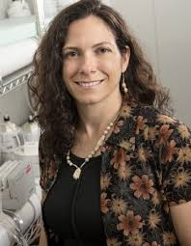
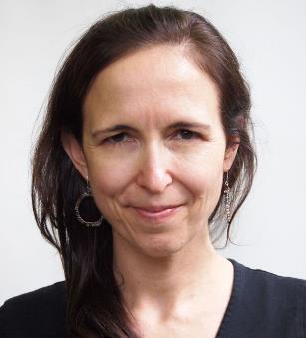


Grateful acknowledgement
National Science Foundation, #1556258
Citizens of Flint
WaterYouFightingFor? (Melissa Mays and LeeAnne Walters)
Hurley Medical Center (Mona Hanna-Attisha and others)
US EPA Region 5 (Miguel Del Toral, Mike Schock, Darren Lytle)
ACLU - Michigan (Curt Guyette, Kate Levy)
Sen. Jim Ananich, Congressman Dan Kildee (and their extraordinary staff)
1500+ donors supporting our work
MI DHHS / Genesee Co. Health Dept
Dr. Amy Pruden
Dr. Yanna Lambrinidou
Democracy Defense League (Nayyirah Shariff, Claire McClinton)
Dr. Laura Sullivan
Northeast-Midwest Institute (Elin Betanzo)
Concerned Pastors for Social Action (Pastors Harris and Overton)
Parents for Non-toxic Alternatives (Dr. Yanna Lambrinidou)
City of Flint (Mayor Karen Weaver, Dayne Walling, Howard Croft, Mike Glasgow)
Members of the media
Virginia Tech (staff and students)

Slide 3
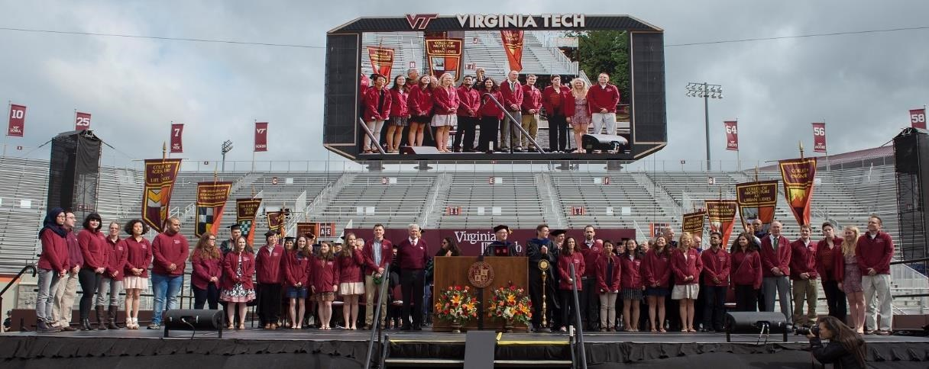
Undergrads: Madeleine Brouse, Margaret Carolan, Sara Chergaoui, Matthew Dowdle, Kim Hughes, Rebecca Jones, Philip Smith, Alison Vick
Graduate Students: Taylor Bradley, Christina Devine, Emily Garner, Catherine Grey, Pan Ji, Anurag Mantha, Rebekah Martin, Jake Metch, Victoria Nystrom, Colin Richards, William Rhoads, Siddhartha Roy, Laurel Strom, Owen Strom, Min Tang, Ni “Joyce” Zhu
Research Scientists: Brandi Clark, Dongjuan Dai, Sheldon Masters, Jeffrey Parks, Kelsey Pieper, David “Otto” Schwake, Fei Wang
Staff: Cassandra Hockman
Principal Investigators: Dr. Marc Edwards, Dr. Amy Pruden, Dr. Joseph Falkinham III

Slide 4
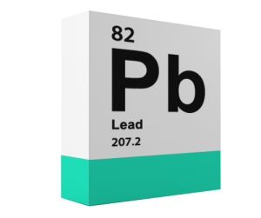
“Lead makes the mind give way”
– Discorides, 2nd Century BCE

Slide 5

the prolific installation of lead pipes across the U.S.:
“a long-running environmental and public health catastrophe”

Slide 6
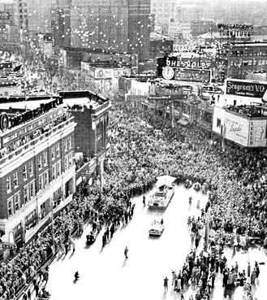
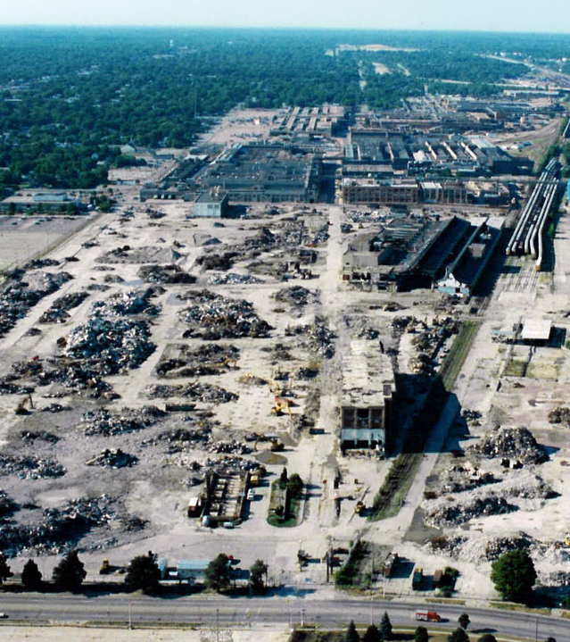
1950s-1960s
1980s-present
The Flint Journal, from http://www.teardownbook.com/photos/
http://www.plan59.com/photos/buickcity.htm
Notes:
In the peak of the auto industry in the 1950s-1960s, Flint had a population of over 200,000 people and had one of the highest per capita incomes in the world. Flint was The American Dream.
As the auto industry there declined starting in the 1980s, Flint suffered steady financial decline. There are now less than 100,000 people living there, and nearly 42% are living below the national poverty line.
This means, due to the financial crisis, beginning in the mid 1980s, there were effectively no new houses built in Flint – which has important implications for lead in water…

Slide 7

Lead
In Brass
No Lead
Lead Solder
Lead Pipe
Graphic Adapted from: http://www.clevelandwater.com/customer-service/protect-your-home/home-tips
Notes:
There is no lead in the water delivered by public utilities, but lead could come from service lines, which connect houses to the water mains. In Flint, an estimated 50% of homes have a lead services line. Lead can also come from the building plumbing as it leaches from lead solder – which is the stuff that holds copper pipes together – or from brass plumbing devices that, until very recently could be made of up to 8% lead.
In 1986, use of lead solder in plumbing was banned, so it is likely that houses built before this time still have lead solder.
The water Flint has long used as their drinking water, purchased form the city of Detroit, had a chemical added to it to provide corrosion control to keep the lead that was in these homes stuck on the pipes and out of the water.

Slide 8
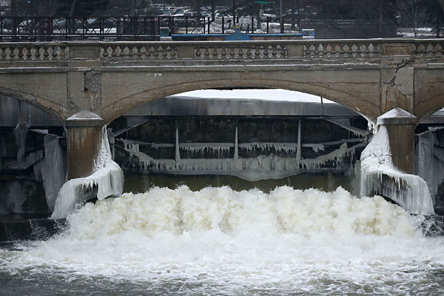
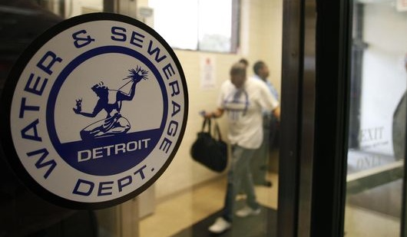
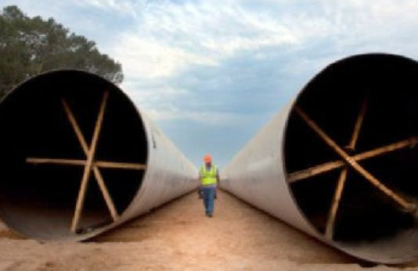

Historic Flint Drinking Water Source
(CCT)
Flint River – Drinking Water Source: April 25, 2014
AP/Paul Sancya
Pipeline to Lake Huron – Projected Completion: Late 2016
Detroit Free Press
Samuel Wilson/The Flint Journal
Notes:
State-appointed Emergency manager decided to switch from Detroit to a new pipeline

Slide 9
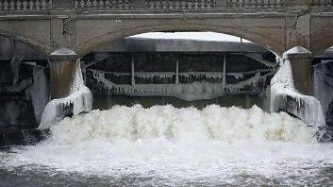

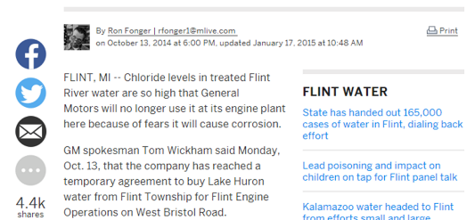
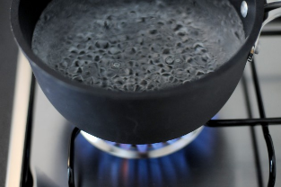
October 2014
General Motors stops using Flint Water
April 2014
Switch to Flint River
January 2015
Exceeds total trihalomethane limit
August - September 2014
Bacteria/E. coli violation

Slide 10
Michigan Department of Environmental Quality (MDEQ) Responsibility
Due to Flint River water chemistry
For Lead Release

Slide 11
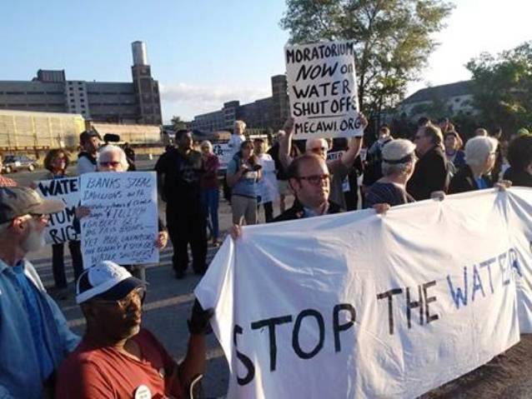


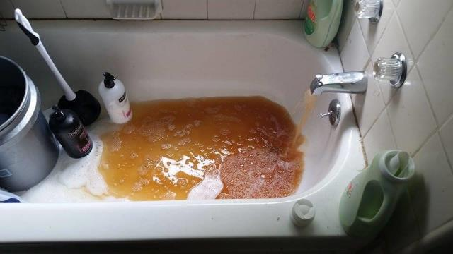
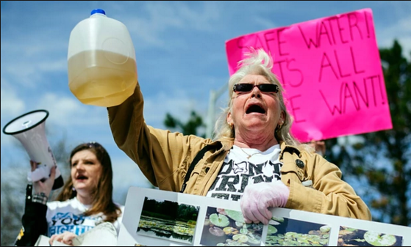
Abayomi Azikiwe
Regina H. Boone—Detroit Free Press/ZumaPress
Sephia8 – mlive.com
Sam Owens/AP

Slide 12
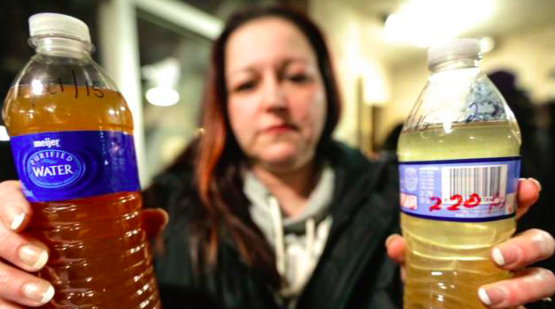
RYAN GARZA/AP
Notes:
Lee-Anne Walters
Family facing health issues. Her daughter’s hair was falling out, one of her twin boys wasn’t hitting the same developmental milestones as his brother, and when she took him to the doctor, she found out he had lead poisoning. The city tested her water twice, and found high levels of lead both times. They attributed it to the fact that she must have had lead in her plumbing, despite her insistence that they had remodeled their house and replaced all the metal pipes. They wouldn’t help her. So Mrs. Walter’s contacted the Environmental Protection Agency (EPA), and was put into contact with one of their scientists Mr. Miguel del Toral
He encouraged her to send some water samples from her house to our lab at Virginia Tech for testing ...
Lead numbers: 0 ppb; Action Level: 15 ppb – Average: 2000; Highest 13000; EPA : 5000 hazardous waste

Slide 13
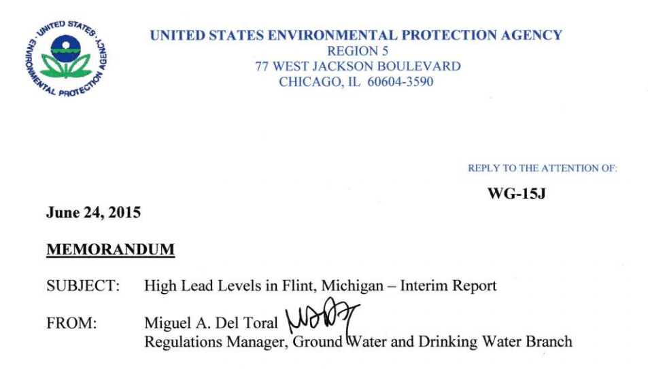
“A major concern from a public health standpoint is the absence of corrosion control treatment in the City of Flint”
Notes:
We shared this data with Mr. del Toro and he immediately drafted a memo and sent it to EPA and MDEQ and raised the alarm about his “major concern” for “public health” and he suggested that Flint might be breaking the law and neglecting to use corrosion control.
When the memo was later leaked to the press, Mr. del Toral was silenced, and publicly discredited by the state, which called him a rouge employee, acting outside his job. At one point, MDEQ bragged to Mrs. Walters that Miguel had been handled. How on earth can you laugh in the face of a mother who’s kid has been lead poisoned is beyond me! And so the best lead expert in the country was silenced.
Observing this dangerous attitude and inaction of both MDEQ and EPA in response to this memo and the citizens concerns, we knew we had to do something to help.

Slide 14
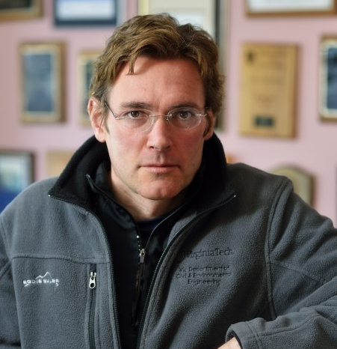

Dr. Marc Edwards
Notes:
Thus the Flint water study was born.
Dr. Marc Edwards led our team of 25 graduate and undergraduate students, post-docs, research scientists, and professors to give credibility and scientific support to the citizens claims.
Over $260,000 of our own money and 6 person years worth of effort

Slide 15
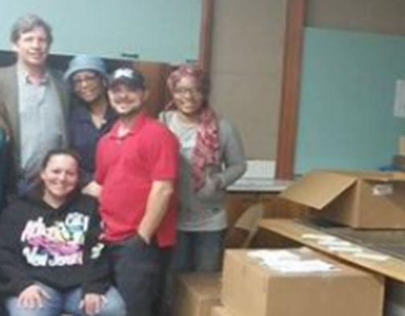
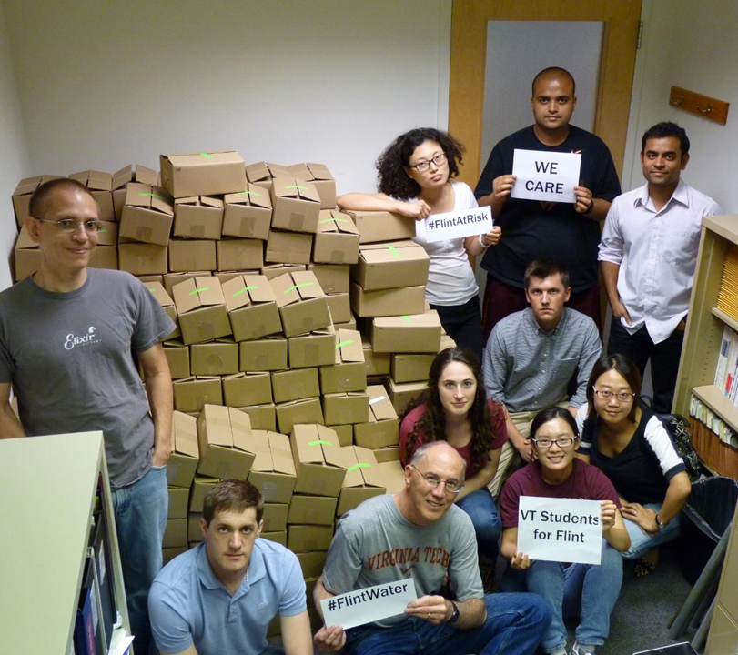
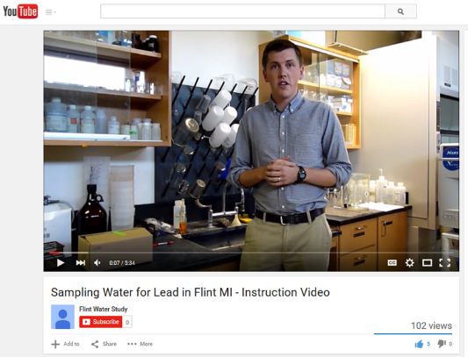
August 13, 2015
300 kits
Notes:
We packed 300 sampling kits to send to Flint to allow residents to test the water in their homes.

Slide 16
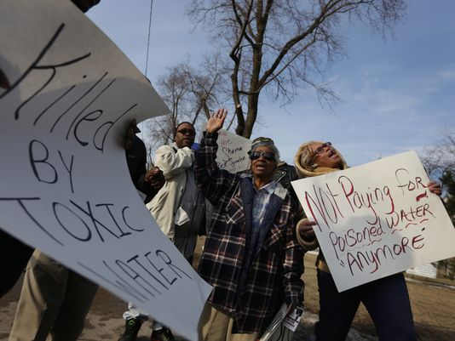
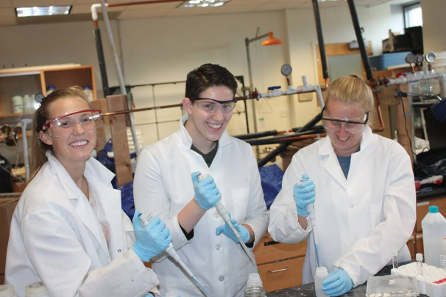
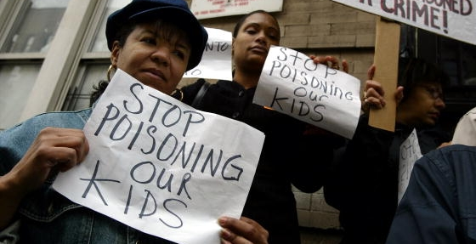
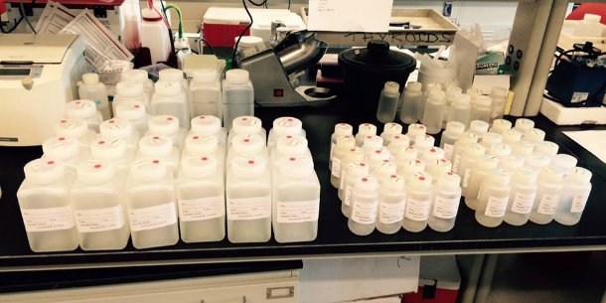
90%
return
rate
Romain Blanquart / Detroit Free Press
Getty Images
Notes:
270 homes -- 90% return rate in four weeks. Lead sampling random in that we didn’t know which homes had a lead pipe. We think of the public as passive recipients of science who we experts educate; but in Flint they were equal partners.

Slide 17
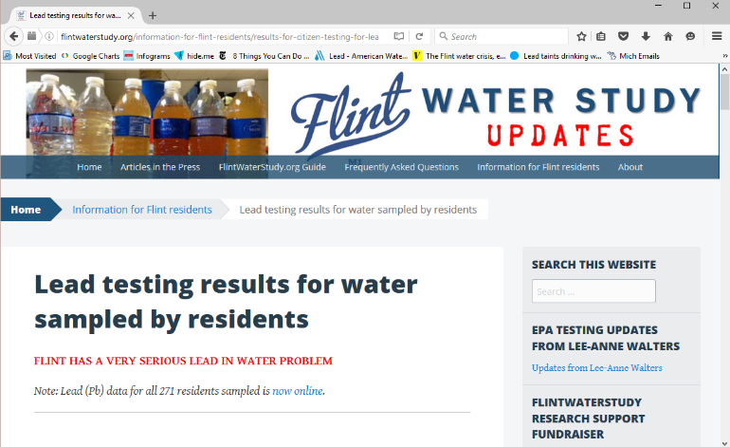
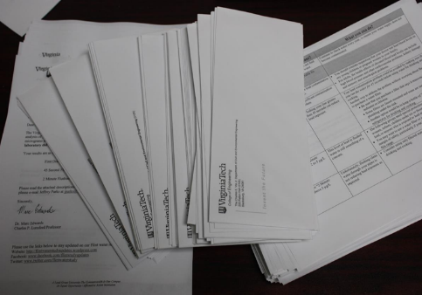
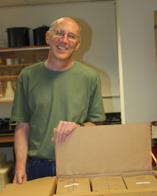
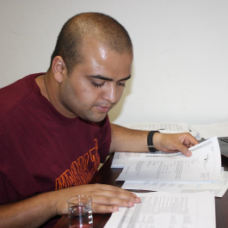
www.flintwaterstudy.org
Letters/Phone calls
Website/Facebook/Twitter launched late August
Purpose:
  Inform Flint residents about water quality issues
  Bring public awareness w/ data and science
  Resident queries framing research questions

Slide 18
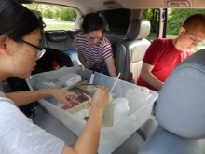
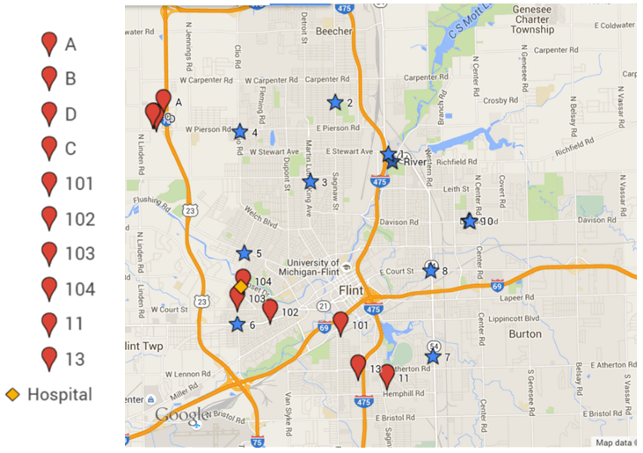
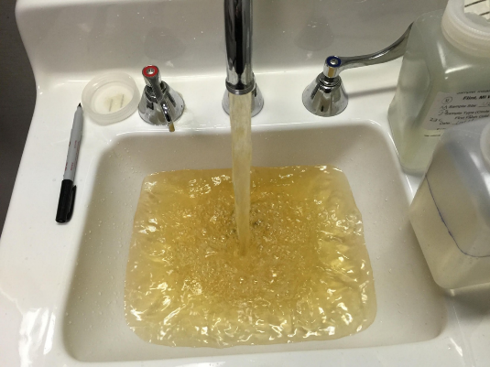
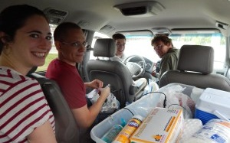
At a Flint hospital
Notes:
An MDEQ official also suggested that the residents we worked with might be adding lead to their sample bottles to get attention.
So we loaded up in a van and went to Flint to confirm their sampling, going to several homes and water department monitoring sites and this is an example of the kind of thing we saw while we were there. We made a total of four trips in 2015 for a variety of water quality testing.

Slide 19
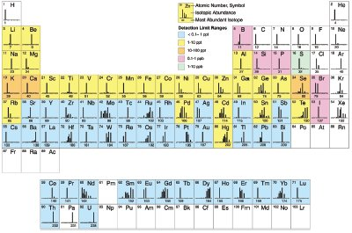
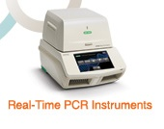
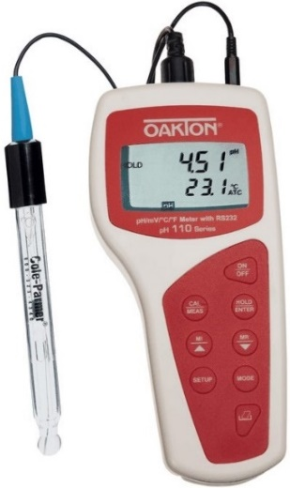
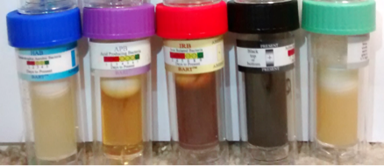
Physical/Chemical
Parameters Measured
Technology
Used
Biological
Parameters Measured
Legionella pneumophila
Legionella spp.
Total Bacteria (16S)
Mycobacterium avium
Mycobacterium spp.
Acanthamoeba polyphaga
Pseudomonas aeruginosa
qPCR
ICP - MS
pH
Temperature
Dissolved Oxygen
Heterotrophic Bacteria
Acid Producing Bacteria
Iron Reducing Bacteria
Sulfate Reducing Bacteria
Slime Forming Bacteria
Denitrifying Bacteria
Probes
BART
Chlorine residual
Chlorimeter
THMs
(Disinfection
by-products)
THMFP
Culture
Staphylococcus

Slide 20
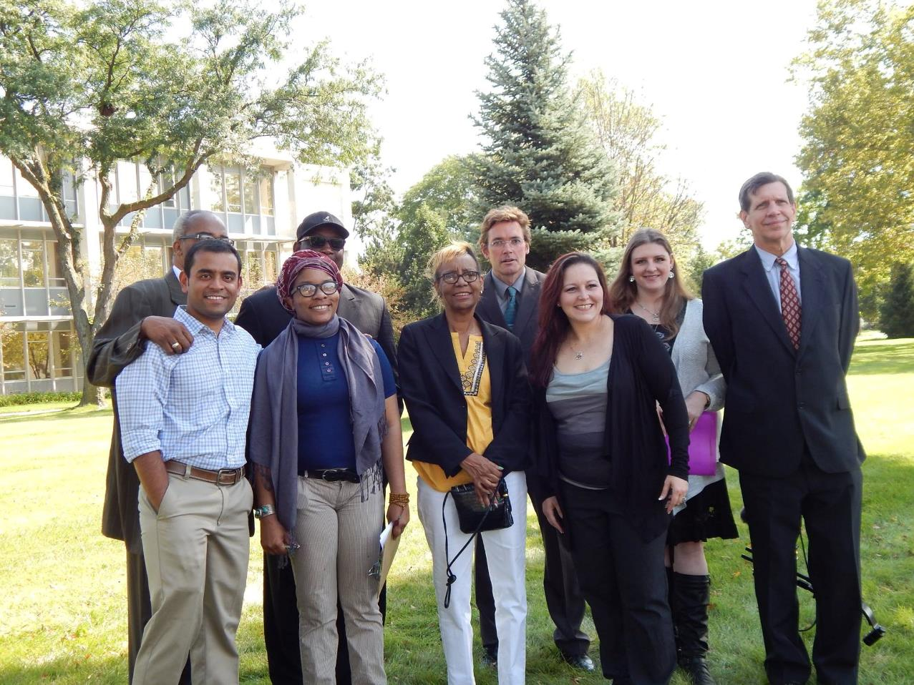
Public Health Advisory Press Conference – September 2015

Slide 21
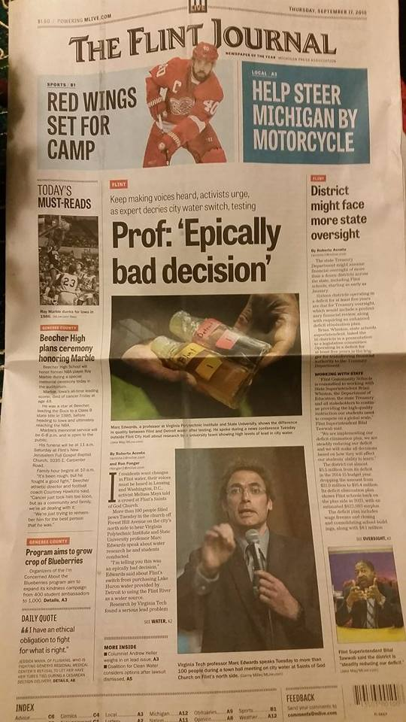
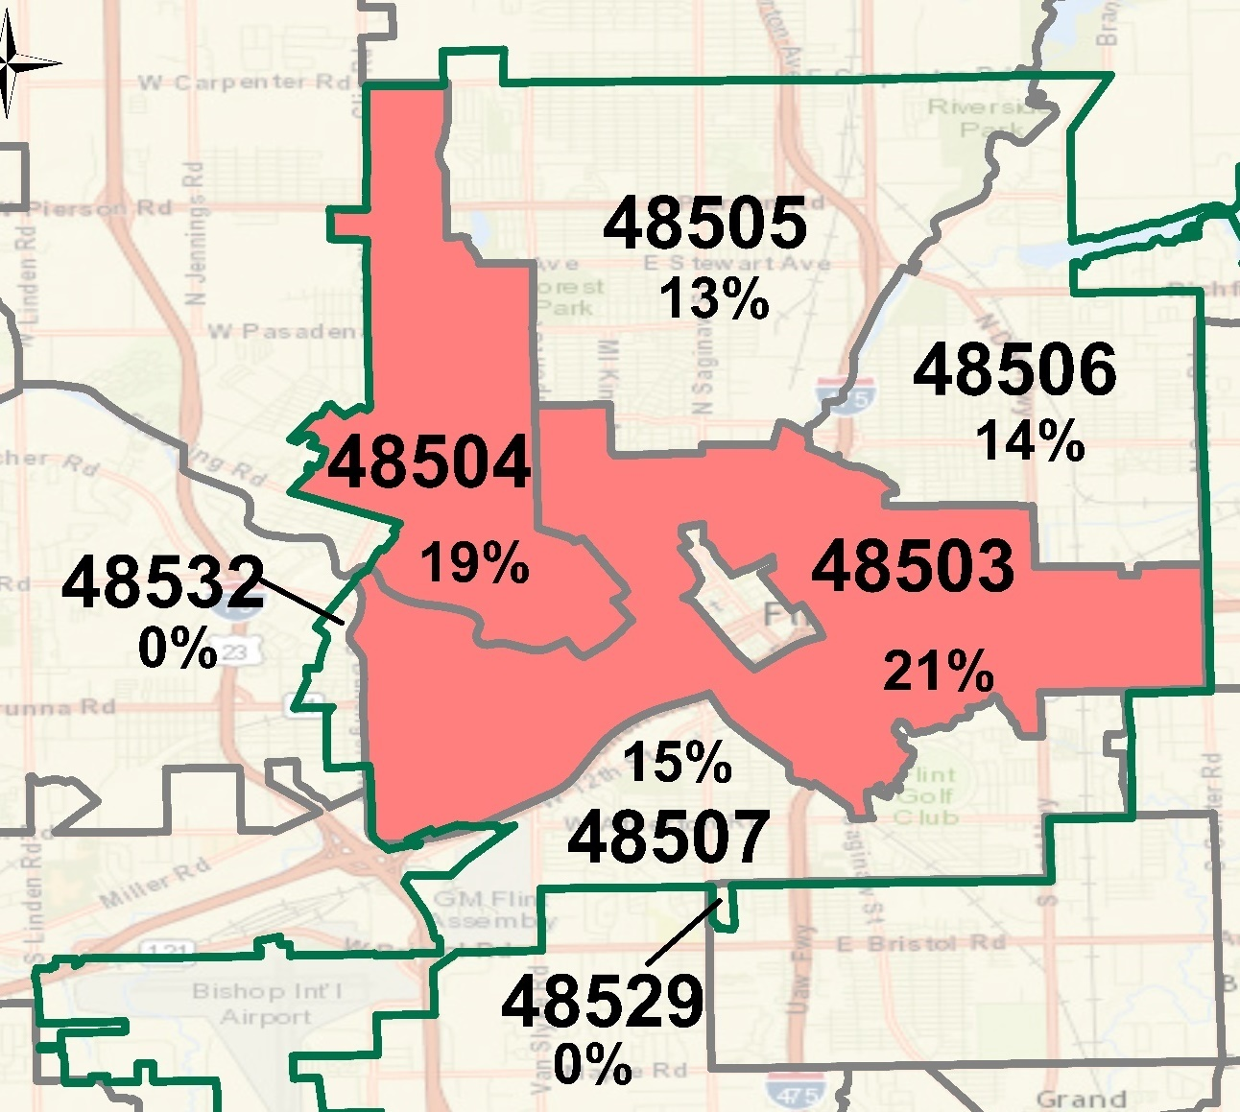
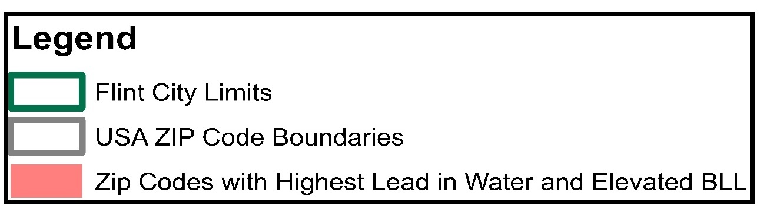
Public Health Advisory:
September 2015
For 269 HOMES:
90%ile for First Draw = 26.8 ppb
EPA Action Level = 15 ppb
Highest First Draw: 158 ppb
Highest overall: 1051 ppb
Notes:
When we had the results in Sep, we went to Flint to share our results at a town hall meeting. There was a widespread lead problem and in two zip codes 1 in every five homes had elevated lead. Clearly, the water was NOT safe to drink!

Slide 22
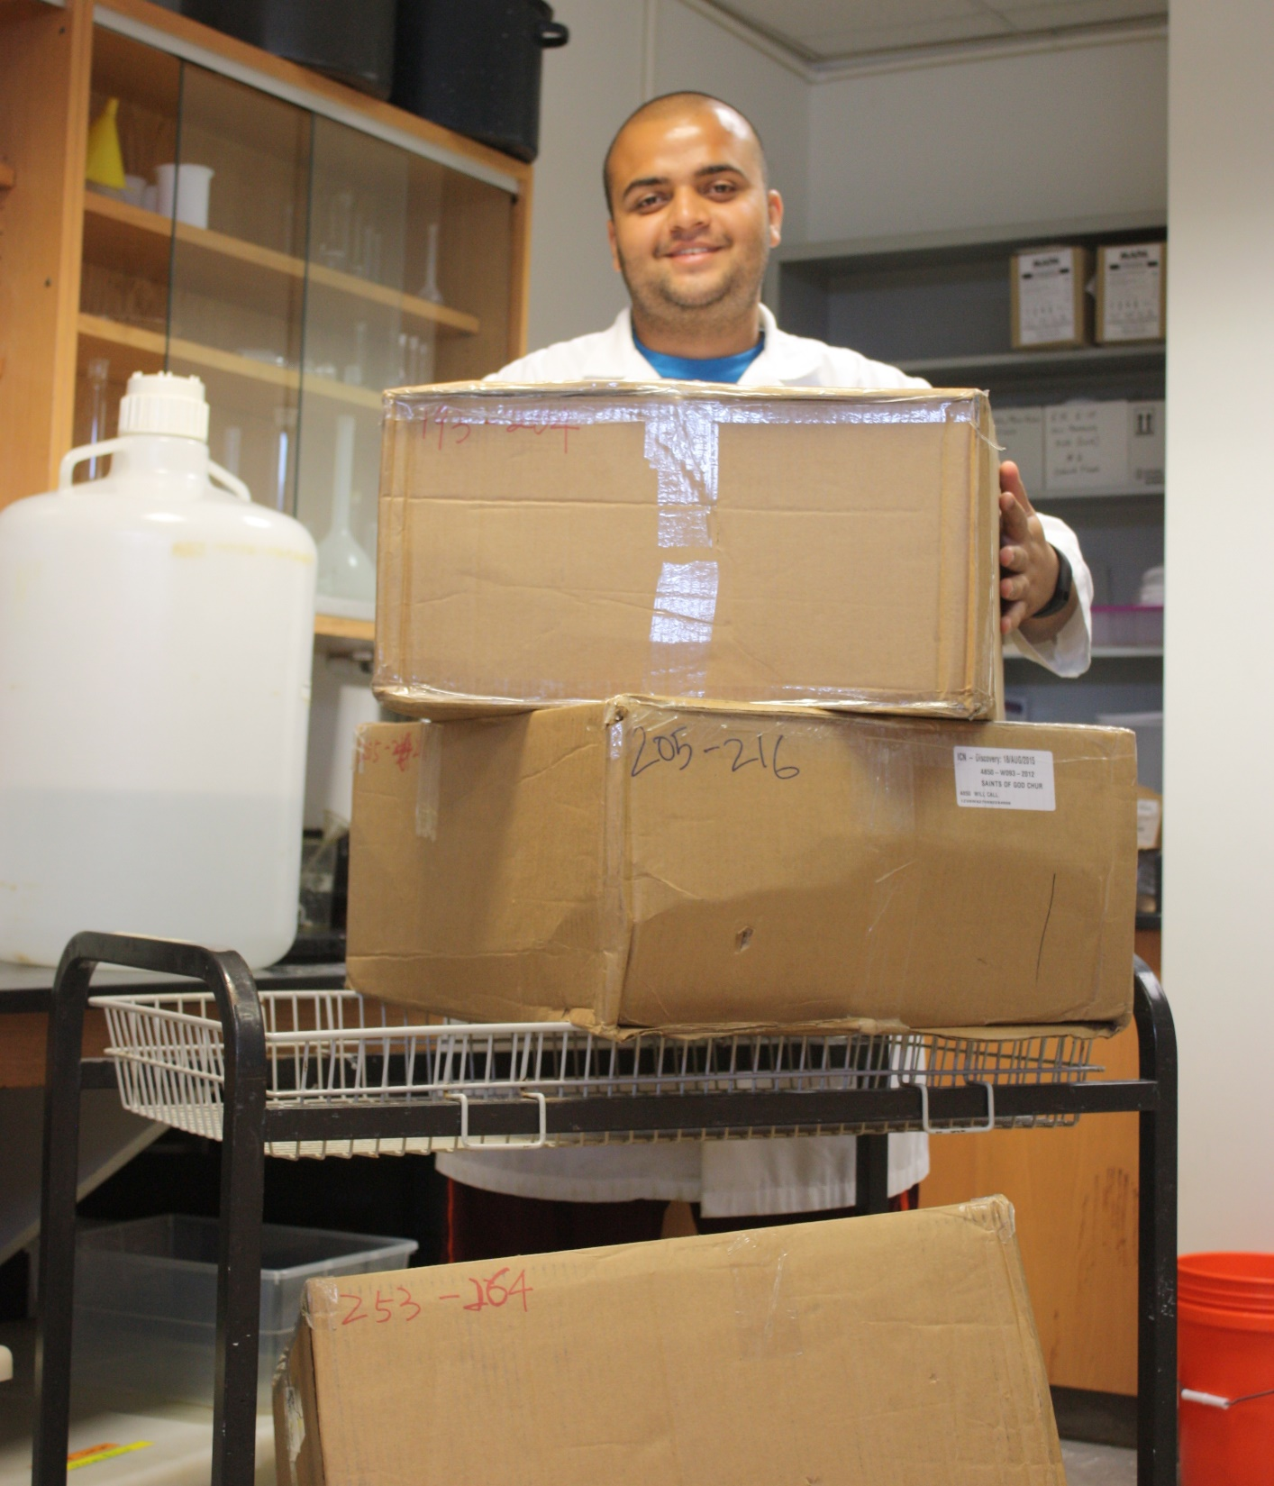
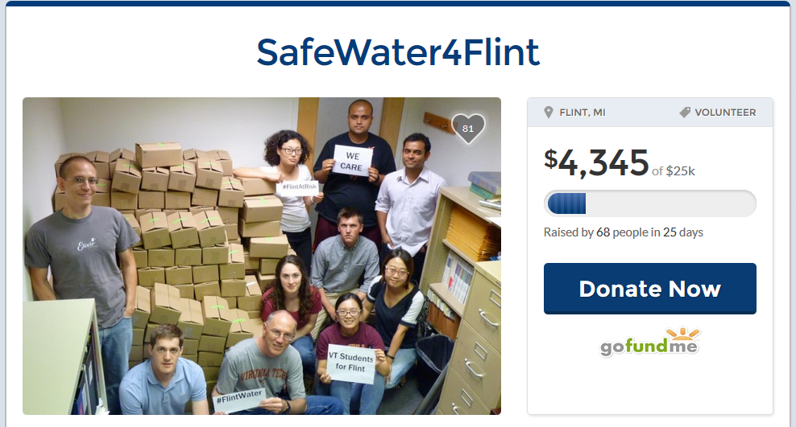
Anurag’s story --
A Compassionate Call to Help!
Notes:
paid the first $100 of his own pocket
Half a million – within two weeks
Service

Slide 23
Response from MDEQ
“This group specializes in looking for high lead problems. They pull the rabbit out of that hat everywhere they go. Nobody should be surprised when the rabbit comes out of the hat, even if they can’t figure out how it is done”
-Brad Wurfel
MDEQ’s Communications Director
Notes:
Science-based public agency. Publicly discredited

Slide 24
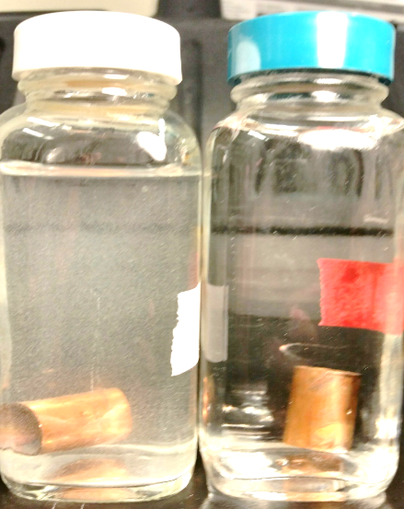
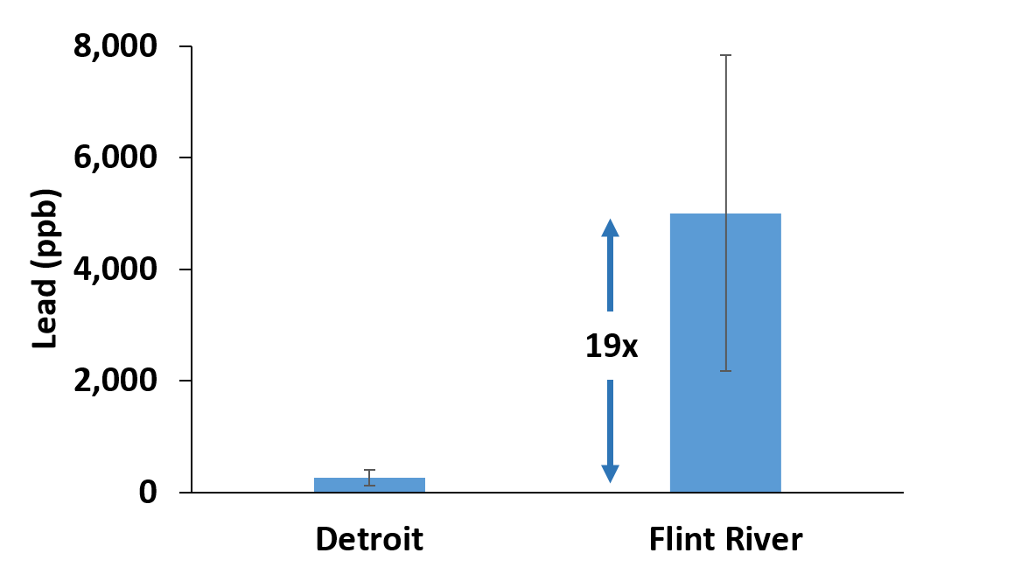
Lead Corrosion Experiment
Flint
Detroit

Slide 25
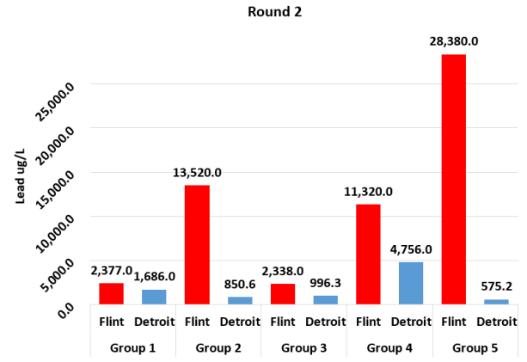
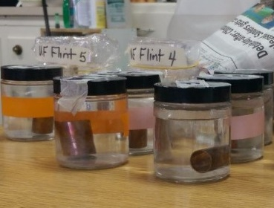
Lead Corrosion Experiment
Ms. Weiss’ class at City School, Grand Blanc, MI
Flint water was always MORE corrosive than Detroit water

Slide 26

Student Observations
“Flint looks like a snow globe and Detroit looks like nothing barely happened” -Caroline
Drew: “…Flint water is DISGUSTING!”
Sophia: “…the Flint water looks bad and unhealthy to drink…”
Ridley: “Flint = SNOW GLOBE”

Slide 27
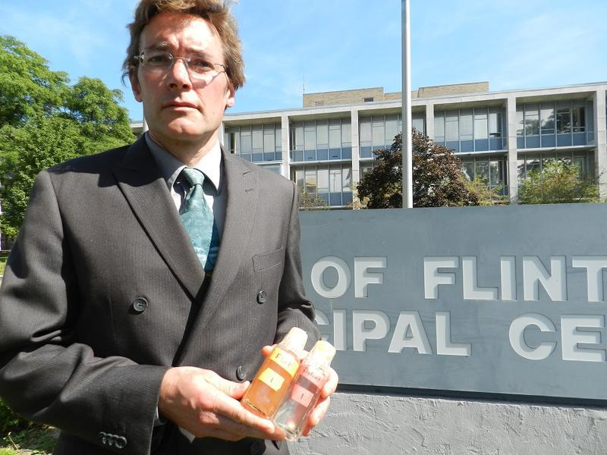
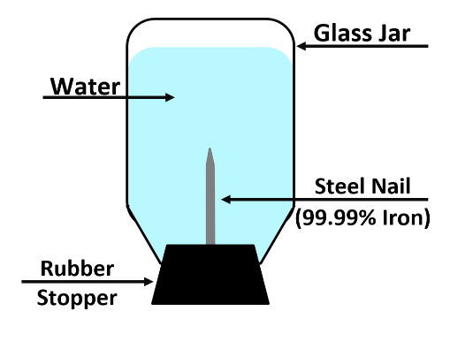
Iron
Corrosion
Experiments
http://mediad.publicbroadcasting.net/p/michigan/files/styles/medium/public/201512/potpurri091515_055.jpg

Slide 28
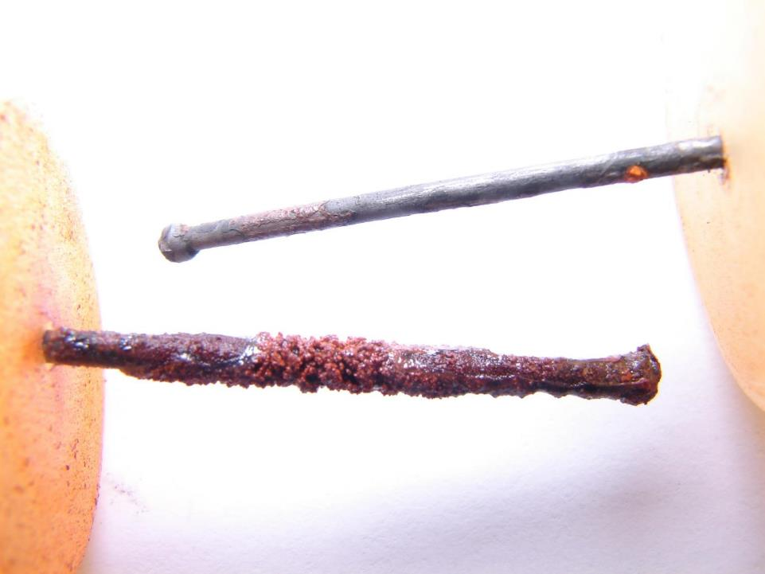
Detroit Water
Flint Water
9X more Fe release

Slide 29


Slide 30

Notes:
2X
3X

Slide 31

http://www.crainsdetroit.com/article/20150928/NEWS01/150929872/doctors-urge-flint-to-stop-using-water-from-flint-river

Slide 32

Notes:
$12 mn spent by State to switch back to Detroit Water
$4mn spent for free water testing, lead filters, blood testing

Slide 33



Legionnaires’ Outbreaks ~ 90 cases; 12 deaths
Flint Water
Switch

Slide 34

Jan 16 2016
Carolyn Kaster/AP
“I KNOW IF I WAS A PARENT UP THERE [IN FLINT], I WOULD BE BESIDE MYSELF IF MY KIDS’ HEALTH COULD BE AT RISK.”
- President Barack Obama, after declaring a federal emergency

Slide 35

18 months
100,000 residents
9000 kids exposed
200 confirmed cases
12 deaths
Legionnaire’s Disease
100s of main breaks
Water > $150/month

Slide 36
THE GOVERNMENT AND THE WATER INDUSTRY BETRAYED FLINT, MICHIGAN
Actors
MDEQ
EPA
Emergency Managers
MI Gov/City of Flint/MI Health Dept.

Slide 37
MDEQ/City of Flint Cheated on Lead Monitoring
ACTUALLY FAILED
W/ 71 SAMPLES
NOW PASSED!
W/ 69 SAMPLES
Notes:
Cheating on lead sampling in Flint
At least 33 US cities use faulty sampling; e.g. Philly

Slide 38
According to Walters, [MI Nurse] stated that “He is barely lead poisoned. If CDC had not changed their lead poisoning standard from 10 down to 5, we would not be having this conversation.”
Angry, Walters protested that [MI Nurse] was minimizing the problem, at which point [MI Nurse] cut her off and said “I am working with kids in their 40’s and 50’s. It is just a few IQ points…it is not the end of the world.”

Slide 39

To hold paramount the safety, health, and welfare of the public – VT (First Canon of Civil Engineering)
The ‘Ut Prosim’ perspective
I’m not so sure Flint is the community we want to go out on a limb for.
- Internal EPA Email
v/s

Slide 40


Notes:
As a people, as a nation, we have to decide what do we care about the most?

Slide 41

Help to Flint
$600+ million in relief
            Bottled water, lead filters, blood testing, Water Bills
            Health, Nutrition, Education Services
            Lead Pipe Replacement
      EPA, MDEQ, VT – Best scientists (and students!) on the ground to improve water quality
      Three Congressional Hearings and 400+ lawsuits
      13 Michigan and Flint civil servants criminally indicted

Slide 42

Notes:
Speaking of trust – No one trusts what the government says, even the filters that they are giving out.
One of the few groups the people of Flint trust are a group of twenty somethings and a professor 13 hours away in Blacksburg, Virginia..
We are working with the State and EPA on the ground and as part of the Flint Taskforce. Round II (March) and III Lead Testing (July)

Slide 43




Spring Break

Slide 44








Summer Vacation

Slide 45

https://twitter.com/thedailyshow/status/688131499615363074
Notes:
If the scientists at MDEQ had done their job right.

Slide 46


































Notes:
10 stories/month before v/s 10-15 stories/day after we got involved. Long overdue conversation on the safety of our tap water and there is renewed scrutiny over our water systems. Our website has garnered over half a million views, close to 600,000 and half of it was during when we were releasing exposes

Slide 47





National Impact
Notes:
Pervasiveness of lead in our water infrastructure
(6-10M lead pipes + countless leaded plumbing)
Corrosion control treatment not sufficiently enforced
A culture of compliance focused on meeting regulations rather than protecting public health
Portland, Newark, Atlanta, Baltimore, Los Angeles,

Slide 48
Lead-in-water testing in our lab (2016)
Cities
Philadelphia, PA
w/ Philly citizens
Pittsburgh, PA
New Orleans
w/ LSU
Flint, MI
Buffalo, NY
Dayton, OH (hospitals)
Public Schools near
UNC Wilmington, NC
Tuskegee College, AL
Atlanta College, GA
Private Wells
North Carolina State
(3 counties)
Orleans, NY
Virginia State
Corrosion Testing
Indianapolis, IN
Brick, NJ
Media Investigations
NBC News (Milwaukee, New Orleans)
HBO
ABC13 (Roanoke, VA)

Slide 49


National Lead Testing w/

Slide 50

"Ut Prosim in its finest spirit."
"Thank you for your heroism."
"Thank you for your integrity and for acting on your moral convictions!
"a credit to this country."
PRICELESS!
"The world would likely not have known if not for you."
"It is people like you who restore faith in humanity!"
"an inspiration to a rising generation of scientists and engineers […] around the world!"
"Hokie Proud!"
"SCIENCE!"

Slide 51

Miguel
Del Toral
Marc Edwards
Lee-Anne Walters
Mona
Hanna-Attisha
vt.edu/flintwater
Notes:
The people of Flint and some outsiders brought this issue to light. Lee Ann, Miguel, Mona, and Marc- and all Flint residents… These are True Heroes! People who put their reputations and their jobs on the line, to save Flint! Strive to be like them.

Slide 52
“Servant Leadership”
VT – a unique & special place – “Ut Prosim” in our DNA
  Service and Heroism prerequisites to doing meaningful work incl. good science
Driven by ethics & focused on those you serve and lead
Increased sensitivity towards injustices – social, environmental, institutional
Never be a bystander to wrongdoing

Slide 53



“We must always take sides. Neutrality helps the oppressor, never the victim. Silence encourages the tormentor, never the tormented.”
– Elie Wiesel (Holocaust Survivor/
Nobel laureate)
www.flintwaterstudy.org
Jake May / AP
Notes:
Thank you so much for having me!
Flint was probably a once-in-a-lifetime opportunity and we are privileged and really lucky that we were able to accomplish this alongside Flint residents. But most importantly, we at Virginia Tech are simply grateful!

